Slide 1

CS361: Computer Architecture
Cache: A deep Dive
Instrcutor:Waheed Ahmad
Week 8 Lec 1: Memory
Reading Sections: : Computer Organization & Design: HW/SW Interface, 5th Edition: Section 5.1
Computer Architecture: A Quantitative Approach, Sixth Edition, Section 2.1
CS324 Computer Architecture 1

Slide 2
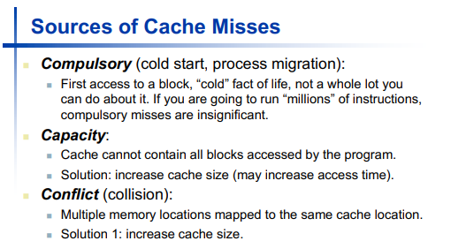


Slide 3
Fully Associative Cache
Analogy: "Park Anywhere"
A piece of data (a car) can park in any available spot in the entire garage (cache).
Pro :
Very flexible.
You'll always find a spot if one exists. No wasted space.
Con :
Very slow to find data.
The CPU has to ask, "Where is my car?" and the cache must check every single parking spot at the same time to find it.
Requires complex and expensive hardware.

Slide 4
Set Associative Cache
Analogy: "Park on Your Assigned Floor"
The garage (cache) is divided into "sets" (floors).
Your data's address (license plate) determines which floor (set) it must go to.
It can park in any of the available spots on that specific floor.
Example: An "8-way" set means there are 8 spots on your assigned floor.

Slide 5
Set Associative (Pros & Cons)
Pro :
A perfect balance!
Fast to find data: The CPU knows exactly which floor (set) to search. It only has to check the 8 spots on that floor, not the 500 spots in the whole garage.
Flexible: Still has a choice of spots, which avoids most "your spot is full" problems.
Con :
It's possible (but unlikely) that your one floor could fill up, even if other floors have empty spots.

Slide 6
Cache Type | Parking Garage Analogy | Where Data Can Go | Speed & Complexity
Direct-Mapped | "Your one assigned spot" | Exactly one specific slot in the cache. | Fastest & Simplest (but high conflict)
Set Associative | "Park anywhere on your assigned floor" | Any slot within its one assigned set. | Balanced Speed & Complexity (The sweet spot)
Fully Associative | "Park anywhere in the garage" | Any slot in the entire cache. | Slowest & Most Complex (but no conflict)

Slide 7
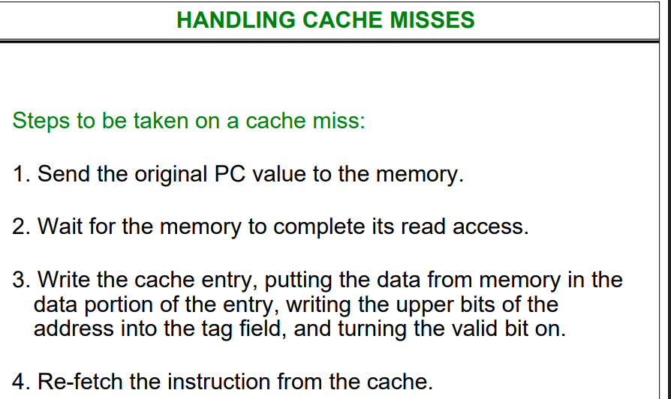

Slide 8
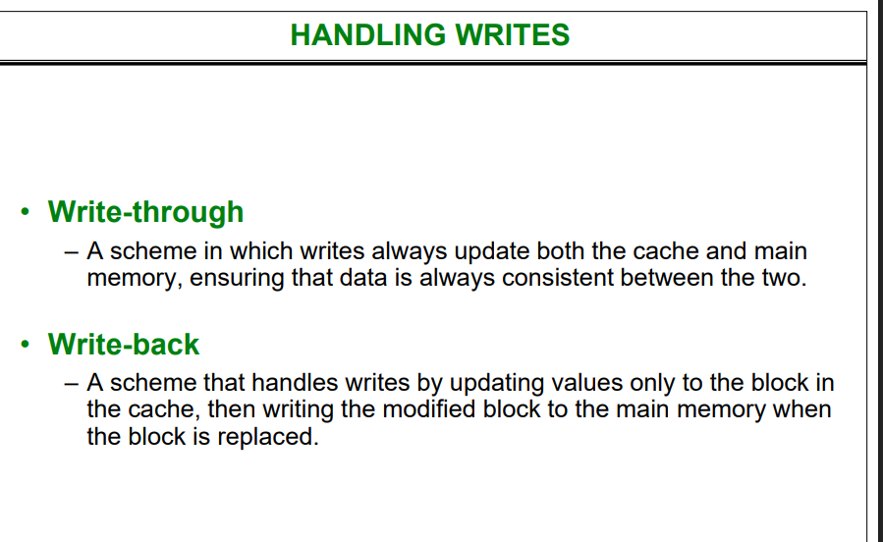

Slide 9
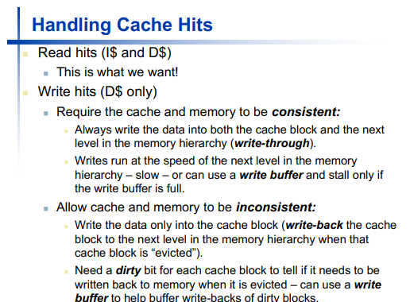

Slide 10
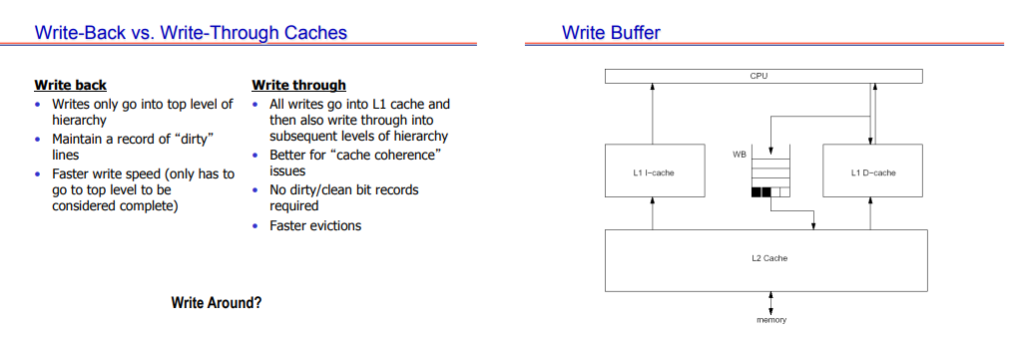
More on this…→

